Slide 1
Examination of GNN performance by message passing and hidden state removal

Slide 2
Target
We would like to examine the message passing and hidden states contribution to the GNN’s performance on classifying nodes as secondary or not and classifying edges as if two nodes are from the same cluster.

Slide 3
Importance of hidden state and message passing
The message passing is responsible for propagation of information between different nodes in the network such that the structure of the graph is taken into account in the output.
Hidden state provide a way to use previous information to effect later ones by storing information near the node features.

Slide 4
Graph Neural Network
A graph is a data structure containing a set of objects called “nodes”, and connection between these nodes called “edges”.
In our neural network, node are associated with tracks, and edges are associated with connection between two nodes.
The node and edges contain information called “node features” and “edge features”.
The graph as a whole can also have global features.
A GN block takes as input an arbitrary graph and output it’s features as updated features.
The GN block is composed from a few neural networks that work together in a sequence to perform a task (classification of nodes and edges).

Slide 5
Data
The data is a table of the following contents:
  Jet features
  Node features which are the position (x,y,z) and momentum (pt) of the tracks.
  Node labels - ground truth of the tracks, 1 if its from secondary vertex and 0 if not.

Slide 6
Node embedding
Get as input the node and jet features.
Transforms the node features into a vector of numbers.
The vector of numbers is added to the node features – we refer it as “hidden state”.

Slide 7
Edge Attention
Get as input the node features with the hidden state and jet features.
Assign weight for a pair of nodes according to the importance of a node to its neighbor.
This neural network is fully connected as if each node is connected to every other node in it’s neighborhood.
The output is edge attention weight.
For each node, a weighted sum of it’s neighbors node features and hidden state is calculated.

Slide 8
Node update
The input is the weighted sum, node features and it’s current hidden state and jet features.
The output is an update hidden state for the node.

Slide 9
Node and Edge classifiers
Based on the updated hidden state, the classifiers can do classification of track as secondary or not secondary node (node classifier) and classification of edges if they are from the same cluster (edge classifier).
The output is a score in range (0,1) for each node and each connection between pairs of nodes.
Nodes above some threshold labeled as secondary nodes.
Edges with a score above some threshold connect nodes to be from the same cluster.

Slide 10
performance
To measure the similarity of the clustering between the algorithm and the ground truth we use Adjusted Rand Index.
The ARI outputs a jet score computed from truth level clustering and the GNN or Jetfitter clustering.
The score is a value between -1 to 1, 1 shows perfect agreement and 0 shows performance similar to random clustering and -1 is the worst possible agreement.

Slide 11
The comparison is between 3 different neural networks:
  GNN
  GNN without message passing – referred as gnn_mes.
  GNN without message passing and without hidden states – referred as gnn_mes_hid.

Slide 12
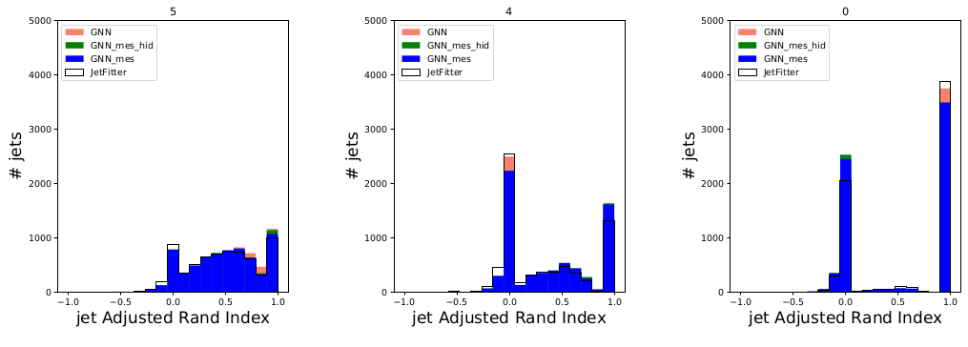
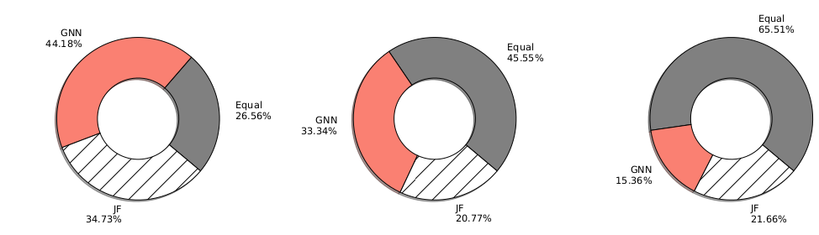

Slide 13
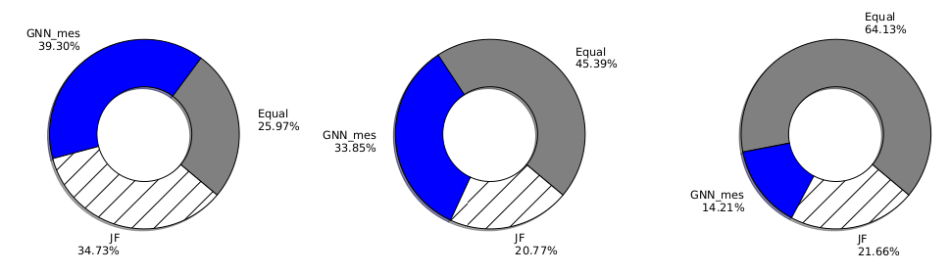
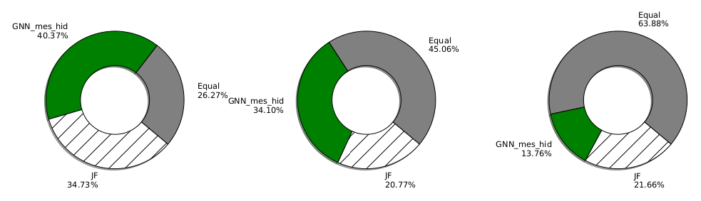

Slide 14
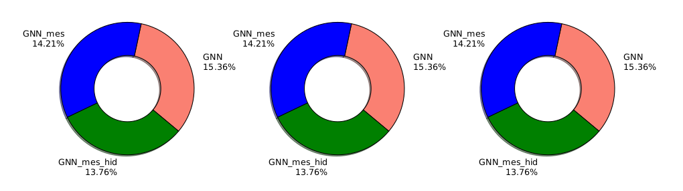

Slide 15
Reconstructed vertices
Reconstructed vertices are groups of tracks associated to a secondary vertex by the GNN or Jetfitter
Categories of reconstructed vertices:
  Perfect - the vertex matches exactly with a true vertex.
  Partial - the vertex contains tracks from a single true vertex.
  Merged - the vertex contains tracks from two or more true vertices.
  Fake - the vertex contains only tracks not originating from a true vertex.

Slide 16
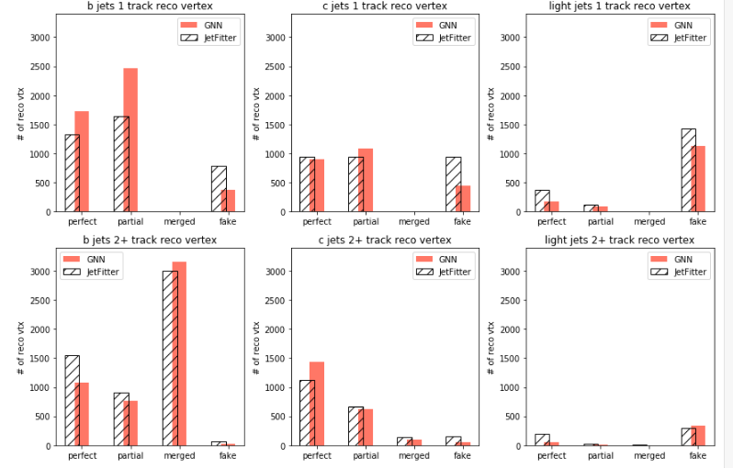
GNN

Slide 17
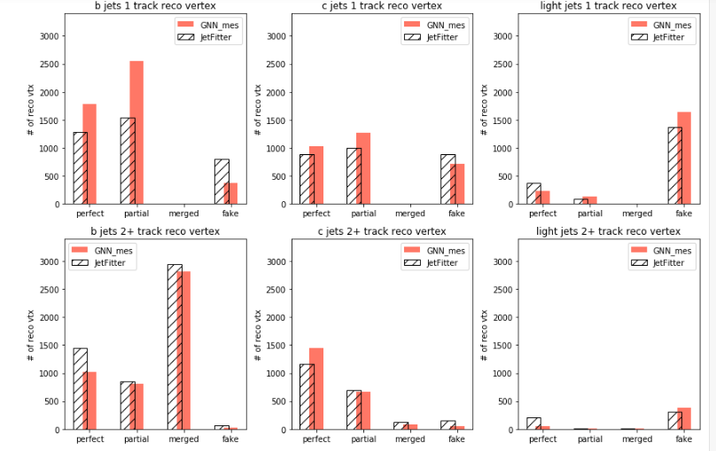
GNN no message passing

Slide 18

GNN no message passing no hidden state

Slide 19
results
We can see that the message passing contribution is greater then the hidden state contribution to the GNN.
Overall, the message passing and hidden state improve the performance of the GNN but not in a significant way.

Slide 20
Edge and Node classifiers separation
The classification of Edges and Nodes is done by the same hidden state so one network (classifier) is affected by the other.
The idea is to separate these networks so that each hidden state will specialize for different task instead of one network having to do both task.

Slide 21
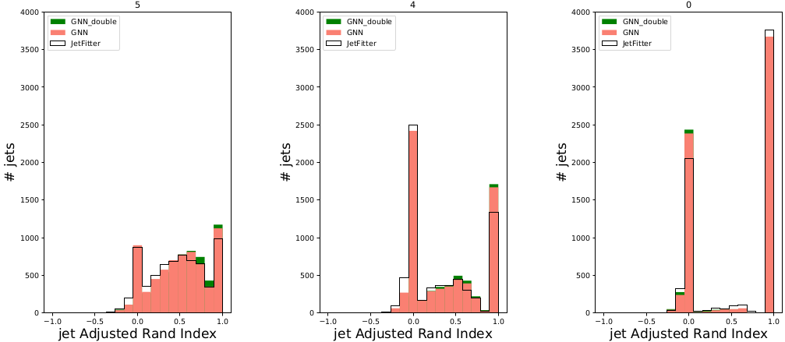

Slide 22
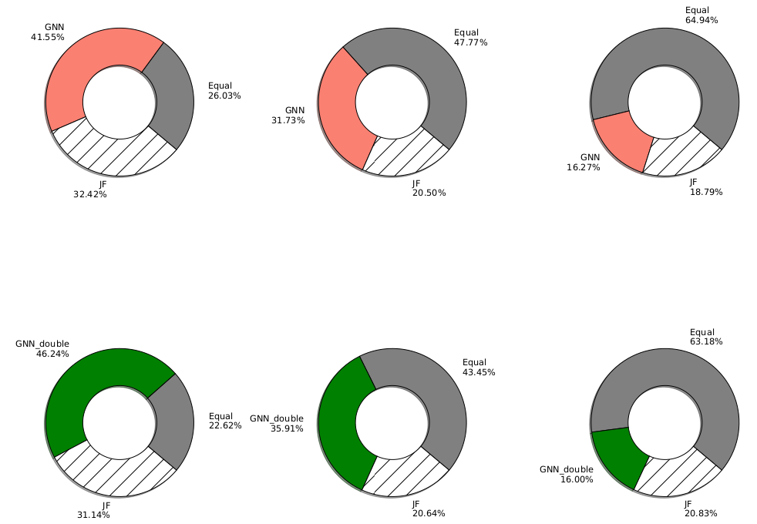

Slide 23
results
The plots show that the separation of the two classifiers improve the performance of the neural network but not in a significant way

